Slide 1
Agenda (times are approximate and will be fluid with the class)
Morning
45 Minutes | Deployment Maturity Review
25 Minutes | DAX Challenge- Part 1
15 Minutes | Review
10 Minutes | Break
25 Minutes | DAX Challenge- Part 2
15 Minutes | Review
25 Minutes | DAX Challenge- Part 3
15 Minutes | Review
10 Minutes | Break
60 minutes | Open Forum
Notes:
Key message: in this workshop we will cover the breath of Power BI capabilities.
After analyzing and visualizing the dataset provided in the workshop, you will use these skills to get started on your own data.

Slide 2
Value
Usually achieved
Often left to chance
Deployment
Technical migration and deployment
Activation
People see new features but don’t know what to do with them
Adoption
People use the solution on a regular basis
Proficiency
People change their behaviours and leverage the full solution
Time
Clear circles of responsibility
Who is responsible for this?

Slide 3




Power BI Adoption Framework
Prove Value
Governance
Roll out
Support
Capability assessment
Suitability Assessment
Business value
Senior Sponsorship
Funding
Key Decisions
Security standards
Infrastructure & Technology changes
Roles and responsibilities
Administration
Data governance, auditing
Ways of working
Phased vs organization wide roll out
License assignment
Change Management
Project prioritisation
Training requirements
Leveraging online resources
Communication
Support Scenarios
Resources/Partners
Realtime support
Internal website
Communities and online resources
Microsoft Advisory Services

Slide 4




WHAT WE DO
CONFIDENTIAL
Valorem Reply’s Data & AI
Enterprise Deployments
Model Dev / Optimization
Data Architecture / Platform
Consultant on Call
Report Dev / Optimization
Complete architectural design and collaborative implementation
Making tabular models as efficient, speedy, robust, and simple as possible
Upstream data warehouse / lakehouse implementation with an eye towards tabular modeling
Hands on sessions with an expert, only when you need them
Designing elegant, professional, responsive reports
Program Management
Security & Data Governance
Digital Strategy / Change Management
Notes:
Valorem’s Point of View regarding Data Estate Modernization (DEM)

Slide 5






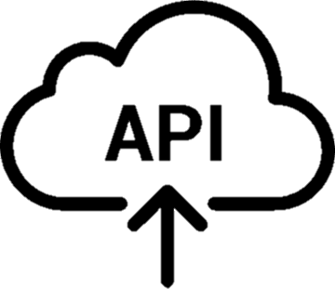




Level 1 – The Lone Developer
CONFIDENTIAL
Attributes Scale 1-6:
Effort: 1
Benefit: 1
Risk: 2
Scalability: 1
Oversight: 2
Expense: 1
User with Power BI Free license
Source Data
Power BI Desktop
Queries and data mashups
Queries
Data
Reports
PBIX files contain 5 capacities
Report
Query
Data
Refresh
Authentication (technically in Azure)
Source Data
Notes:
The lone developer is just a single person, working from free tools on their own PC. They connect to data (either in the cloud or on-premises), do some transformations, model their data, and build a report. It’s all free and all done by one person.
The data artifact they create has a file type of PBIX. This is a zipped collection of files which has a few big pieces, which we’ll want to keep in mind as we go along:
The front-end report charts/graphs/images/etc.
The query that is passed back to the source
The authentication that is used to run the query (technically, this is stored under your M365 account in Azure)
The imported data, which is compressed with the Vertipaq engine and modeled relationally into a cube
The refresh, which for now is manually done with a button click
I’m going to rate these deployment models on some KPIs. Here’s how I rate this:
Very low effort. This is easy
Very low benefit. The developer may benefit a lot, but all the work sticks with and helps only them.
Fairly low risk. If someone stole your developers computer, they would have all the compressed data stored in the PBIX file. If the developer made a mistake in their logic, it impacts on their processes/person
Very low scalability. Hard to share the wealth.
Fairly low oversight. This developer controls everything, which is a blessing and a curse. IT has no eyes on this. No tracking or usage stats
Very low expense: this is all free

Slide 6


Level 2 – Local Sharing
CONFIDENTIAL
Attributes Scale 1-6:
Effort: 3
Benefit: 2
Risk: 3
Scalability: 2
Oversight: 1
Expense: 1
User with Power BI Free license
Source Data
Power BI Desktop
Queries and data mashups
Queries
Data
Reports
Cloud
Source Data
User with Power BI Free license
Power BI Desktop
Queries
Data
Reports
Notes:
Now imagine our lone developer wants to share their work with a few other people. Lacking technical savvy (or funding), they turn to free methods of distribution: email or company cloud drives
Other users can need benefit from this work by having a replica of the PBIX file on their own laptops. Let’s rate these along the same KPIs as before
Effort: Goes up. The developer has to email or store the file and others have to download it. Each person has to manually refresh their own local copies of the data
Benefit: Goes up. A few people can now use and benefit from this report
Risk: Goes up. Because the copies of the data and report are distributed, the security risk is higher. Business logic errors now impact multiple business people/areas
Scalability: Goes up. Through a manual process of link following, downloading, and refreshing, many people can benefit. However, each person must refresh, which has impact on the backend system at scale
Oversight: Goes down. Now you have many people with many copies on many machines.
Expense: Remains flat. All still free

Slide 7






Level 3 – Basic Power BI Service Sharing
CONFIDENTIAL
Attributes Scale 1-6:
Effort: 2
Benefit: 2
Risk: 2
Scalability: 3
Oversight: 3
Expense: 2
M365 Administrator
Licensing Process
Data modeler/ Report designer
Source Data
Power BI Desktop
Queries and data mashups
Queries
Data
Reports
Workspace viewers
Role/Access Process
Workspace Admin
Power BI Service
My Workspace
Source Data
Publish .pbix file
Dashboards
Alerts
Reports
Print, Export, Download
Workbooks
Datasets
On-Premises Data Gateway (Standard Mode)
Gateway administrator
Scheduled data refresh or Direct Query for data sources within the corporate network
Network & Server
Notes:
At some point, local sharing with free tools is no longer desirable or sustainable. PBI offers a cloud based platform for this called the Power BI Service. So beyond development activities, all sharing occurs in this platform. This changes things in complexity quiet a bit.
We’re entering the world of licensing now and can no longer use things cost free. At a minimum, developers and viewers need a Pro license, which is $10/person/month. We’ve also added in an administrator now (M365 Admin
We are also now in a place where we’ve got the possibility of a cloud-based platform interacting with an on-prem data source. This requires several new pieces
To facilitate that connect of PBI Service to on-prem, we need a door. This is a separate tool called the PBI Gateway, which will need to run inside the desired network on a machine which is never off.
Normally, this means you’ve got to involved a network administrator and have access to some kind of server.
Finally, we now have a method for centralizing and scheduling data, it’s refresh, and authentication. This can all be handled by the PBI Service. That lives in a workspace and we add in yet another person: The workspace admin, who grants permissions to view reports.
It’s worth noting here that the PBI Service comes with a wealth of functionality, but for this Level 3 basic usage, we’re ignoring all that.
Let’s see how this impacts our kpis
Effort: Goes down. We centralized and 1 person can do work for many people
Benefit: Remains the same. Roughly the same number of people are helped
Risk: Goes down. The data is on less PCs, and if someone leaves, nothing leaves on their PC. Azure owns the security of it’s platform and what’s on it. Your developer can still screws things up though.
You’re also now officially at the place where you can implement basic Row Level Security to enhance security. Tenant, Workspace, and Report level security is available as well, though most of that kicks in at higher levels.
Scalability: goes way up. We can scale this out to hundreds of users with little additional effort
Oversight: Goes way up. We can now see who view reports, who can do what, where the data is, when it will hit our backend server, etc.
Expense: Goes up. We now have a per-user license fee to pay

Slide 8



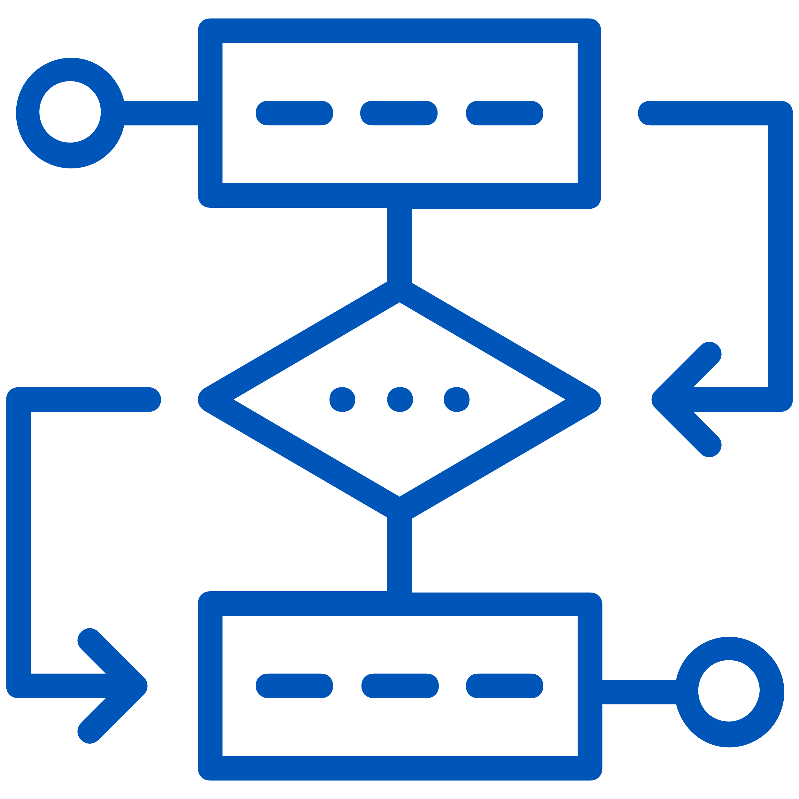
Level 4 – Basic Development Team
CONFIDENTIAL
Attributes Scale 1-6:
Effort: 3
Benefit: 4
Risk: 3
Scalability: 4
Oversight: 2
Expense: 3
M365 Administrator
Licensing Process
Data modeler
Source Data
Power BI Desktop
Queries and data mashups
Queries
Data
Reports
Workspace viewers
Role/Access Process
Workspace Admin
Power BI Service
Workspace
Source Data
Publish .pbix file
Workspace Access
Alerts
Excel
Power BI Desktop
Dashboards
Subscriptions
Analyze in Excel
Live Connection
Reports
Print, Export, Download
Workbooks
On-Premises Data Gateway (Standard Mode)
Workspace admins, members, and contributors
Dataflows
Datasets
Gateway administrator
Scheduled data refresh or Direct Query for data sources within the corporate network
Network & Server
Notes:
At some point, your lone developer needs company. Now you’ve got multiple people building reports against a dataset. For now we’ll assume only 1 dataset. Let’s look at what that adds
Additional licensing and access requests. Report developers will need licenses and access to a role which allows them to live-connect to a dataset and then publish a report
Additional PBI Desktop installations (and updates)
Your original lone developer is likely to take on a new role (or be replaced by someone with this new role): the data modeler. They will own the quality and enhancement of a model for other developers to use in reporting
Your team of developers are going to begin building reports of their own and publishing them. This begins to hint at our next level, where considerations of separating data artifacts becomes important
Let’s see how that impacts our KPIs:
Effort: Goes up. More processes for licensing and workspaces, more oversight, more publishing
Benefit: Goes up again. We’re close to true data democratization at this point. Increasing benefits from here for your business will mostly be marginal
Risk: Goes up. Provided your data modeler has done their work well, little additional risk is incurred by allowing people to build reports. But multiple develoeprs opens the possibility of copying over anothers code.
Scalability: Goes up again. Now we can have several developers doing work side by side, enabling more and more viewers
Expense; Goes up. Each new developer needs a new license and the overhead costs of your administrators has increased

Slide 9



Level 5 – Large Size Deployment
CONFIDENTIAL
Attributes Scale 1-6:
Effort: 4
Benefit: 5
Risk: 1
Scalability: 5
Oversight: 4
Expense: 5
3rd Party Tools
Power BI Premium
Data Management:
Workspace admins, members, and contributors
Report Management
Workspace admins, members, and contributors + build permission on the dataset
Source Data
Data Modeler
Queries and data mashups
Power BI Desktop
Premium Capacity Admin
Power BI Service
Dataset
Workspace Admin
Workspace
Workspace
Publish .pbix file
Workspace Access
Power Query Online
Role/Access Process
Check in/ out Process
Code Repo
Workspace Access
Live connection to shared dataset
Dataflows
M365 Administrator
Dataset
Dashboards
Licensing Process
Source Data
Power BI Desktop
Report
Workspace
Reports
Publish .pbix file
Workspace Access
Publish app
Report Designer
View only users
App
On-Premises Data Gateway (Standard Mode)
Reports
Gateway administrator
Scheduled data refresh or Direct Query for data sources within the corporate network
Dashboards
Publish app
App
View only users
Network & Server
Report management
Workspace admins, members, and contributors + build permission on the dataset
Notes:
At a true Enterprise Scale multiple new factors come to play.
We’ve begun having all code stored in a code repository, with a check-in/check-out process. This is true for Datasets, DataFlows, and reports.
This also means we’ve begun working with 3rd party tools: Tabular Editor, DAX Studio, Vertipaq Analyzer, etc.
We’ve separated the roll of the Data Modeler from the Report Builder. Going forward, report builders will live-query Datasets published in the Power BI Service
Workspaces are now artifact specific. Data artifacts (DataFlows and Datasets) are stored in one workspace, which is then live-queried by reports that live in their own workspace.
We’ve introduced Power BI Apps, which is a method of distributing content to end users which ban be customized to individual user-bases
We’ve also moved from the shared storage-and-compute backend system that we get access to through Power BI Pro licensing and have purchased dedicated cloud hardware for storage and compute. This is called Power BI Premium
How does this impact our KPIs?
Effort goes up. We have new processes to follow, new environments to build
Benefit goes up again. We’ve created an environment to greatly expand the number of report developers without undo access or permissions.
Risk goes down. The code repo acts as a basic disaster recovery environment. Roles and users are as distributed and separate as possible. High-grain permissions can be controlled at the tenant level
This is the first time you can go beyond RLS and get into Object (Table/Column) level security
Scalability: Goes up. We can now add as many users as we wish, till our hardware is maxed out
Oversight: Through the admin portal and the addition of a new staff member (Premium Capacity Admin), we can monitor reports, refreshes, datasets, dataflows, access, response times, etc.
Expense: Goes up markedly. PBI Premium is not cheap, plus the cost of the repo and the new staff

Slide 10

Level 6 – Enterprise Deployment
CONFIDENTIAL
Attributes Scale 1-6:
Effort: 4
Benefit: 6
Risk: 1
Scalability: 6
Oversight: 6
Expense: 4
3rd Party Tools
Power BI Premium
Mobile Reporting & MDM
Source Data
Data Management:
Workspace admins, members, and contributors
Report Management
Workspace admins, members, and contributors + build permission on the dataset
Data Modeler
Power BI Desktop
Center of Excellence
Deployment Pipeline
Deployment Pipeline
Dataset
Training
Project Mgmt.
Workspace
Workspace
Source Data
Publish .pbix file
Workspace Access
Power Query Online
Oversight
Data Dictionary/ MDM
Code Repo
Workspace Access
Live connection to shared dataset
Dataflows
Security Review
Power BI Desktop
Dataset
Dashboards
Premium Capacity Admin
Report
Workspace
Reports
Workspace Admin
Publish .pbix file
M365 Administrator
Workspace Access
Publish app
Report Designer
View only users
Official Processes
App
On-Premises Data Gateway (Standard Mode)
Reports
Role/Access Process
Gateway administrator
Scheduled data refresh or Direct Query for data sources within the corporate network
Dashboards
Publish app
App
View only users
Check in/out process
Network & Server
Report management
Workspace admins, members, and contributors + build permission on the dataset
Licensing Process
Notes:
At a true Enterprise Scale, we polish off a few missing pieces:
We add in a Center of Excellence, in which we provide guidance, training, feedback, and project planning for any current and future projects.
We also move all of our processes and their documentation into the Center of Excellence to review, maintain, and implement
This also means our Administrators need to be involved in the CoE so they can keep a close eye on what they need.
We formalize our deployments to go through Pipelines of Dev > Test > Prod with split responsibilities for auditing purposes
We add in mobile device management for people to consume reporting on their phones while remaining secure
What does this do to our KPIs: - Effort remains static. You still have many processes to follow, but now they’re consolidated into a single place, with a team that reviews and follows them
Benefit goes up: This is the most robust system and one with the greatest internal training and ability to serve large groups while keeping quality high
Risk remains low: You have systems and protocols in place, plus a built-in review board. This is roughly as good as it gets
Scalability goes up: The CoE enables internal training, a clear place to get skills, the opportunity for only mildly overseen projects without reverting to the Wild West
Oversight goes way up. All your admins and their tools are meeting regularly to review security concerns and talk through details
Expense goes down. Theres more beurocracy here but also you’re serving a huge range of departments and needs now. At this point, you can expense out IT costs by department based on usage of Premium capacity resources too, lowering costs

